Slide 1
Measures of Central Tendency (2)
Md. Ismail Hossain Riday

Slide 2
Descriptive measures
In previous chapter, we discussed how a raw data set can be organized and summarized by tables and graphs.
Another method of summarizing data set precisely is to compute number (a single number).
Number that can be describe data sets are called descriptive measures

Slide 3
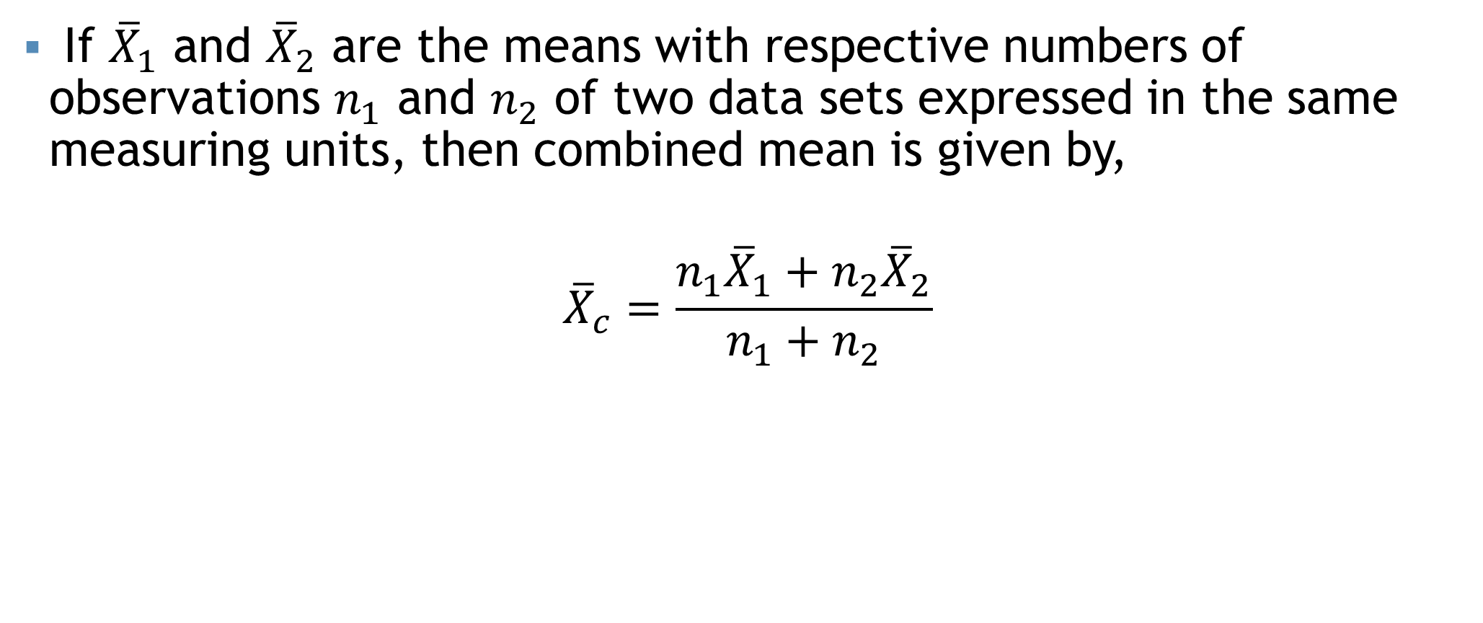
Combined Mean
If ${\overline{X}}_{1}$ and ${\overline{X}}_{2}$ are the means with respective numbers of observations $n_{1}$ and $n_{2}$ of two data sets expressed in the same measuring units, then combined mean is given by,
$${\overline{X}}_{c}=\frac{n_{1}{\overline{X}}_{1}+n_{2}{\overline{X}}_{2}}{n_{1}+n_{2}}$$

Slide 4
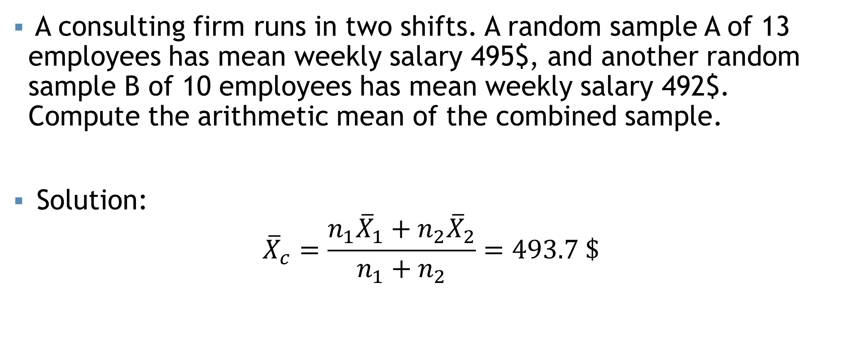
Combined Mean
A consulting firm runs in two shifts. A random sample A of 13 employees has mean weekly salary 495$, and another random sample B of 10 employees has mean weekly salary 492$. Compute the arithmetic mean of the combined sample.
Solution:
$${\overline{X}}_{c}=\frac{n_{1}{\overline{X}}_{1}+n_{2}{\overline{X}}_{2}}{n_{1}+n_{2}}=493.7 \$$$

Slide 5
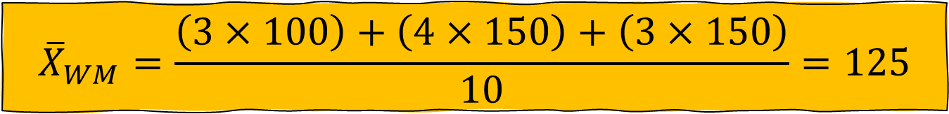
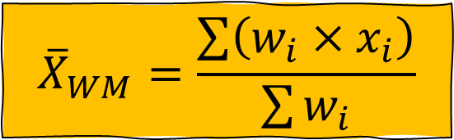
Weighted mean
$${\overline{X}}_{WM}=\frac{\sum{\left(w_{i}×x_{i}\right)}}{\sum{w_{i}}}$$
The weighted mean is a special case of the arithmetic mean. It occurs when there are several observations of the same value.
To explain- Suppose a burger company offers three different kinds of burger packages small, medium and large for Tk. 100, Tk. 125 and Tk. 150. Of the last 10 burgers sold 3 were small, 4 were medium and 3 were large. To find the mean price of the last 10 burger packages sold.
$${\overline{X}}_{WM}=\frac{\left(3×100\right)+\left(4×150\right)+\left(3×150\right)}{10}=125$$

Slide 6
Self Practice
Madina Construction Company pays its part time employees hourly basis. For different level of employee, the hourly rate is Tk 50, Tk 75 and Tk 90. There are 260 hourly employees, 140 of which are paid at Tk 50 rate, 100 at Tk 75 and 20 at the Tk 90 rate What is the mean hourly rate paid to the employees?

Slide 7
Median
Middle value of the observation.
After they have been arranged/ordered from smallest to largest.

Slide 8

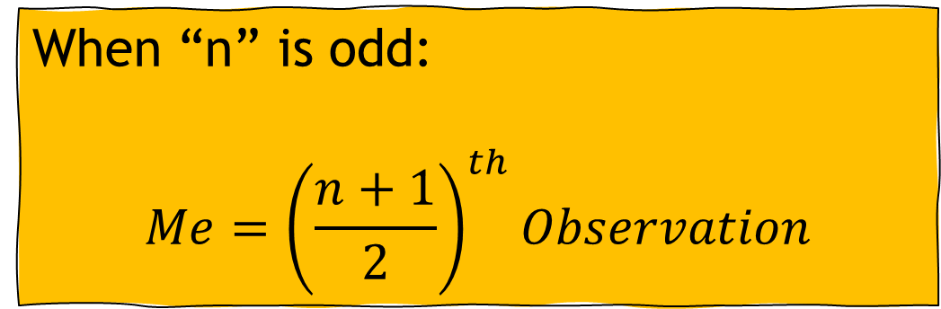
Median for Ungrouped data
There are two types of formula for ungrouped data
When “n” is odd:
$$Me={\left(\frac{n+1}{2}\right)}^{th}Observation$$
When “n” is even:
$$Me=\frac{{\left(\frac{n}{2}\right)}^{th}Obs.+{\left(\frac{n}{2}+1\right)}^{th}Obs.}{2}$$

Slide 9
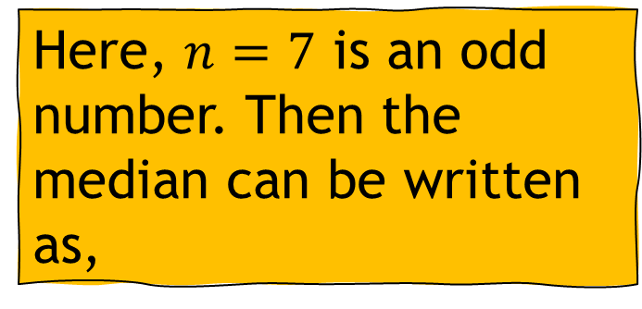
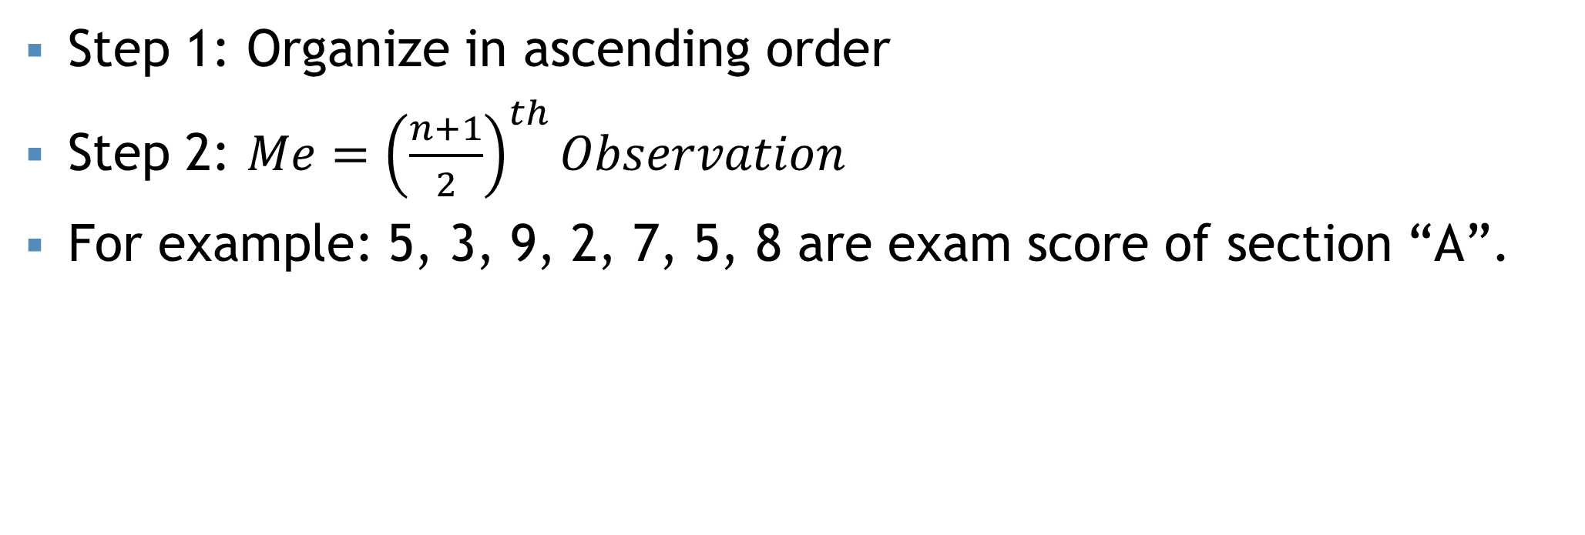

“n” is odd
Step 1: Organize in ascending order
Step 2: $Me={\left(\frac{n+1}{2}\right)}^{th}Observation$
For example: 5, 3, 9, 2, 7, 5, 8 are exam score of section “A”.
Organize in ascending order:
2, 3, 5, 5, 7, 8, 9
Here, $n=7$ is an odd number. Then the median can be written as,
$$Me={\left(\frac{n+1}{2}\right)}^{th}Obs.$$
$$∴Me=5$$
Comment: The median score of section “A” is 5

Slide 10
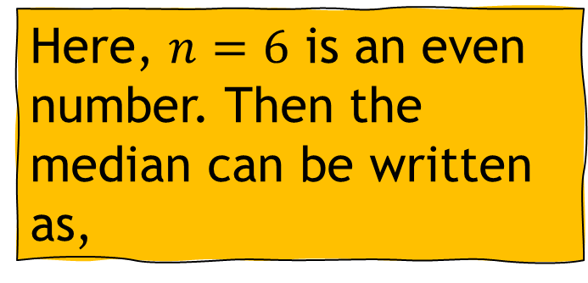
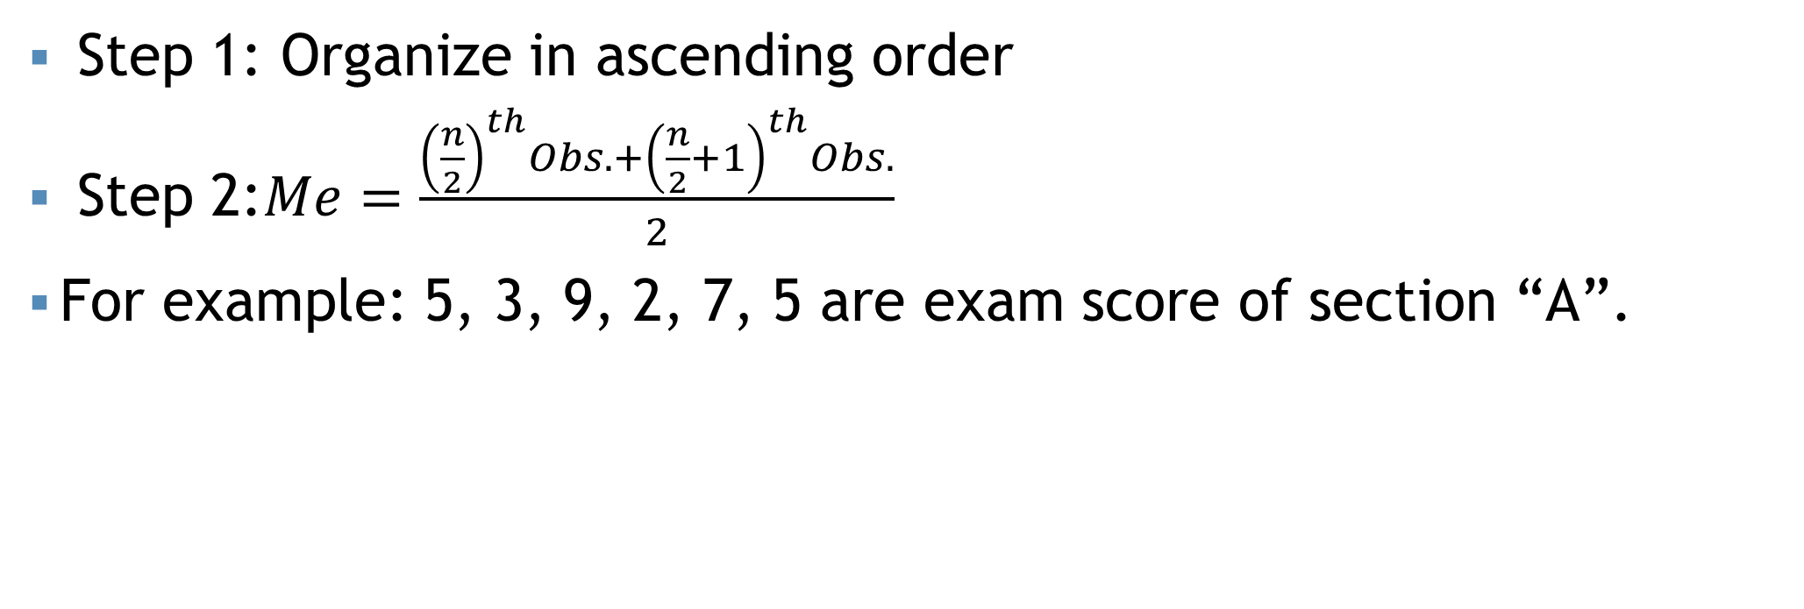

“n” is even
Step 1: Organize in ascending order
Step 2:$Me=\frac{{\left(\frac{n}{2}\right)}^{th}Obs.+{\left(\frac{n}{2}+1\right)}^{th}Obs.}{2}$
For example: 5, 3, 9, 2, 7, 5 are exam score of section “A”.
Organize in ascending order:
2, 3, 5, 7, 8, 9
Here, $n=6$ is an even number. Then the median can be written as,
$$Me=6$$
Comment: The median score of section “A” is 6

Slide 11
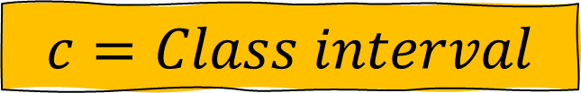
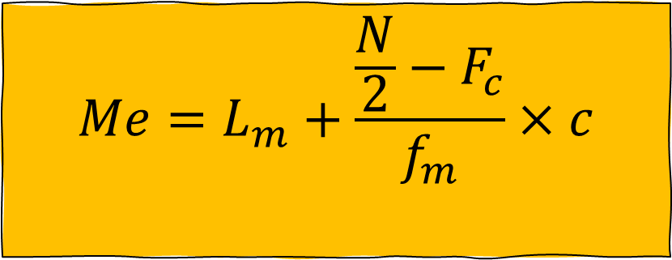
Median for grouped data
$$Me=L_{m}+\frac{\frac{N}{2}−F_{c}}{f_{m}}×c$$
$$L_{m}=Lower limit of median class$$
$$N=Total number of observations$$
$$F_{c}=Cumultative frequency of pre−median class$$
$$f_{m}=Frequency of median class$$
$$c=Class interval$$

Slide 12
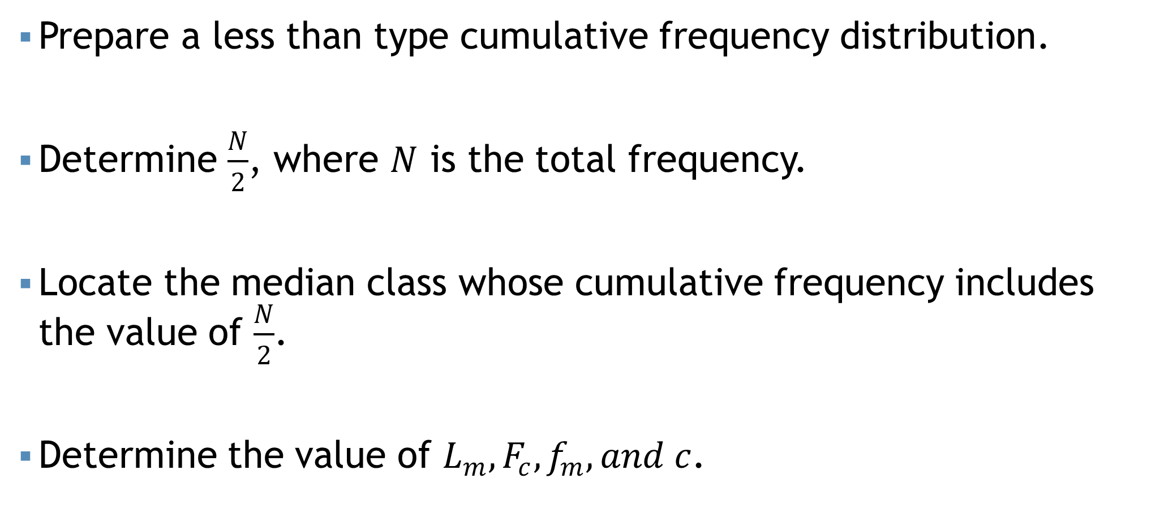
Steps…
Prepare a less than type cumulative frequency distribution.
Determine $\frac{N}{2}$, where $N$ is the total frequency.
Locate the median class whose cumulative frequency includes the value of $\frac{N}{2}$.
Determine the value of $L_{m},F_{c},f_{m}, and c$.

Slide 13
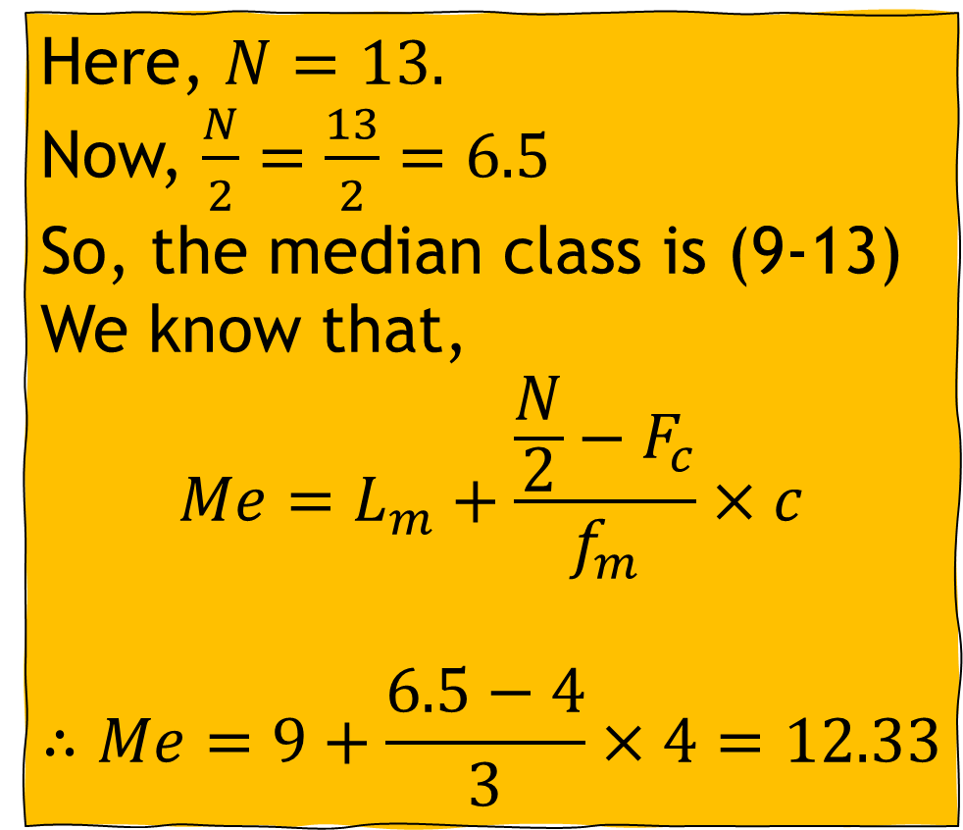
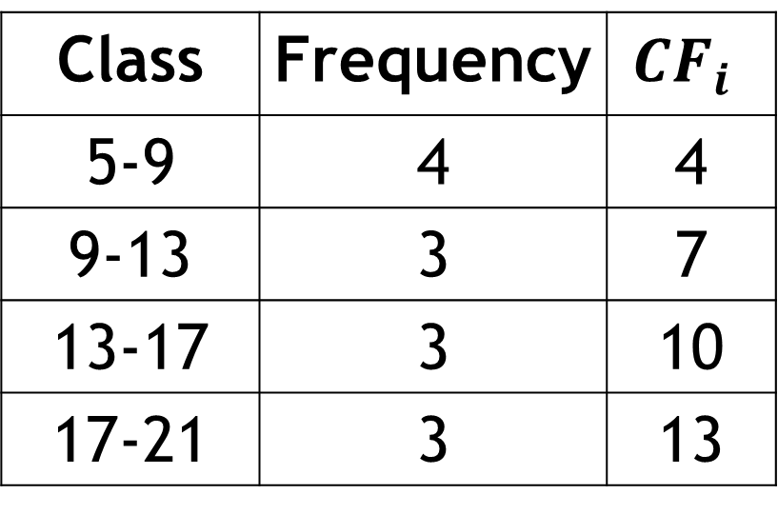
Median for grouped data
Class | Frequency | $$CF_{i}$$
5-9 | 4 | 4
9-13 | 3 | 7
13-17 | 3 | 10
17-21 | 3 | 13
Here, $N=13.$
Now, $\frac{N}{2}=\frac{13}{2}=6.5$
So, the median class is (9-13)
We know that,
$$Me=L_{m}+\frac{\frac{N}{2}−F_{c}}{f_{m}}×c$$
$$∴Me=9+\frac{6.5−4}{3}×4=12.33$$

Slide 14
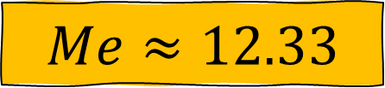
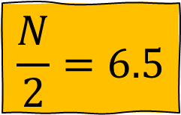
Median from graph
$$\frac{N}{2}=6.5$$
$$Me≈12.33$$

Slide 15
Mode
One mode = Unimodal
Two mode = Bi-modal
More than two = Multimodal
Most frequent value
Occurs more than one times.
For example: 1, 2, 2, 5, 5, 3, 6, 6, 6, 4
Here the most frequent value is 6.
Thus the mode value is 6, and this is a unimodal data.

Slide 16
Mode
Example: 1, 2, 3, 4, 5, 6, 7, 8, 9, 10
There is no value which occur more than one time. Thus there is no “Mode” in this data set.

Slide 17
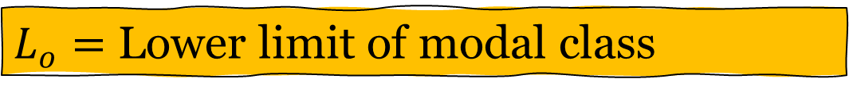
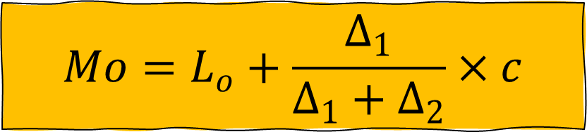
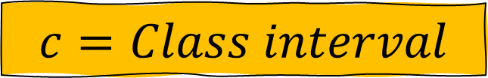
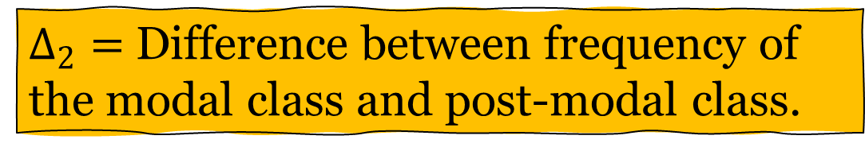
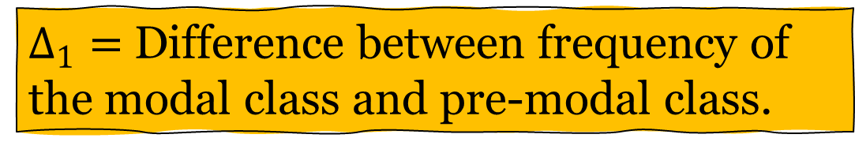
Mode for grouped data
$$Mo=L_{o}+\frac{Δ_{1}}{Δ_{1}+Δ_{2}}×c$$
$L_{o}=$ Lower limit of modal class
$Δ_{1}=$ Difference between frequency of the modal class and pre-modal class.
$Δ_{2}=$ Difference between frequency of the modal class and post-modal class.
$$c=Class interval$$

Slide 18
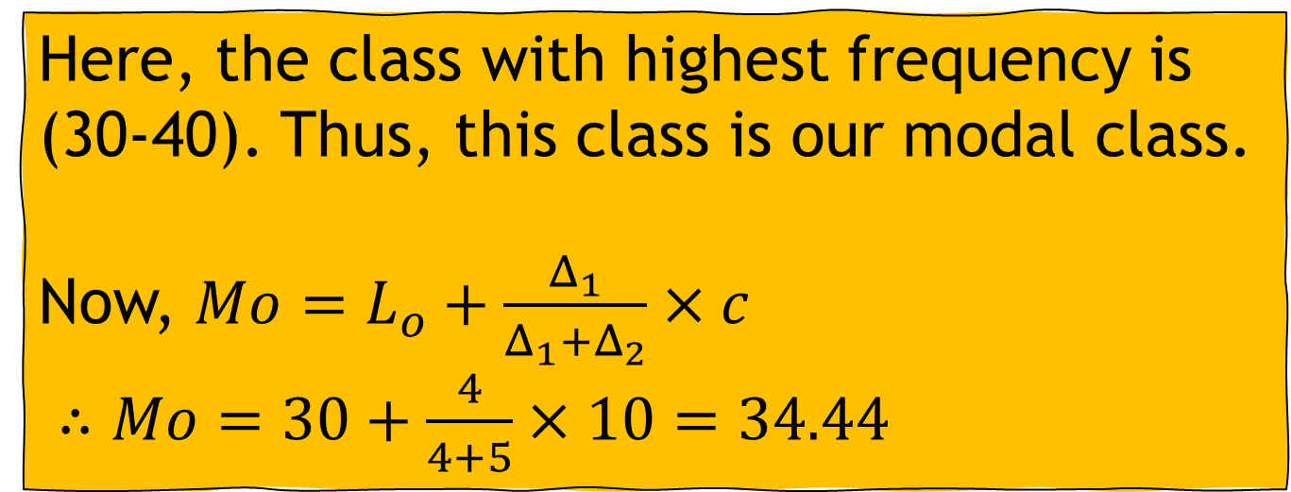
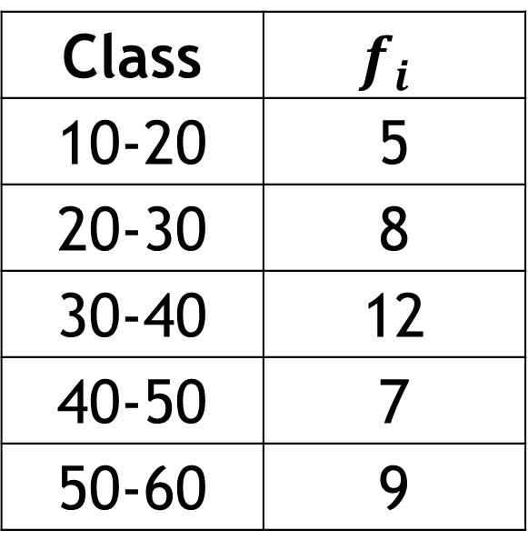
Mode for grouped data
Class | $$f_{i}$$
10-20 | 5
20-30 | 8
30-40 | 12
40-50 | 7
50-60 | 9
Here, the class with highest frequency is (30-40). Thus, this class is our modal class.
Now, $Mo=L_{o}+\frac{Δ_{1}}{Δ_{1}+Δ_{2}}×c$
$∴Mo=30+\frac{4}{4+5}×10=34.44$

Slide 19
Some points…
Does all data have a Mean, median, and mode?
Every set of continuous data possesses a median, mode, and mean.
When considering ordinal data, it encompasses solely a median and mode.
Nominal data solely involves a mode

Slide 20
Measures of Location
We have learned that median divided a set of data into two equal parts.
In the same way, we can divides a set of data into
Four equal parts
Ten equal parts
Hundred equal parts
Quartiles
Deciles
Percentiles

Slide 21
Q, D, and P
Quartiles: Divide the data set into four equal parts. So, we get 3 quartile points: Q1, Q2, and Q3
Deciles: Divide the data set into ten equal parts. So, we get 9 decile points: D1, D2, D3, … , D9.
Percentiles: Divide the data set into hundred equal parts. So, we get 99 percentile points: P1, P2, P3, … , P99

Slide 22
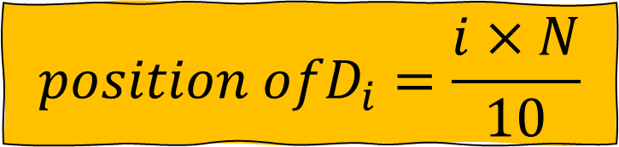
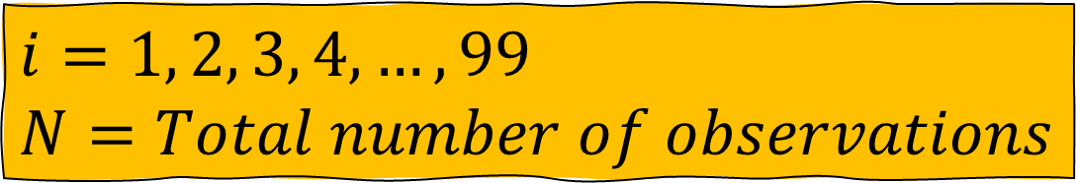
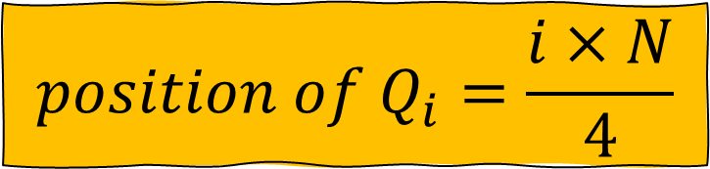
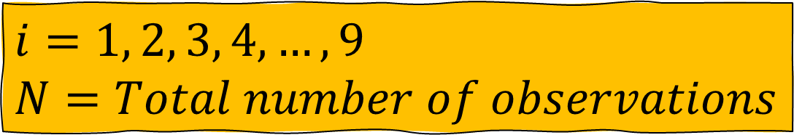
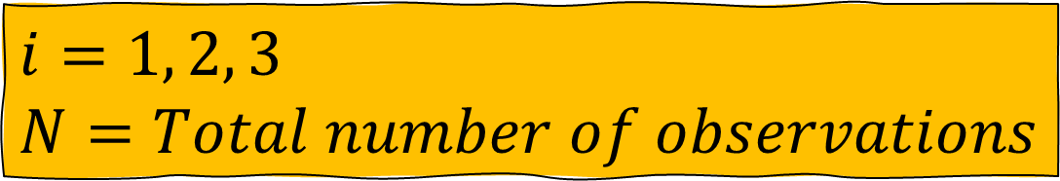
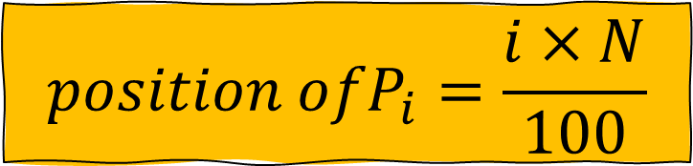
Q, D, and P (Ungrouped)
$$position of Q_{i}=\frac{i×N}{4}$$
$i=1, 2, 3$
$N=Total number of observations$
$${position ofD}_{i}=\frac{i×N}{10}$$
$i=1, 2, 3, 4, …,9$
$N=Total number of observations$
$${position ofP}_{i}=\frac{i×N}{100}$$
$i=1, 2, 3, 4, …,99$
$N=Total number of observations$

Slide 23
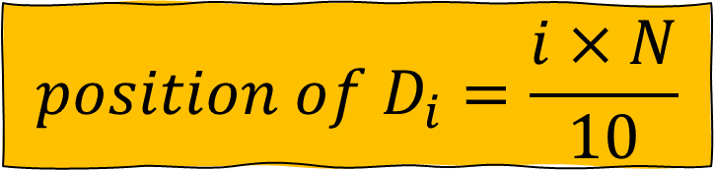
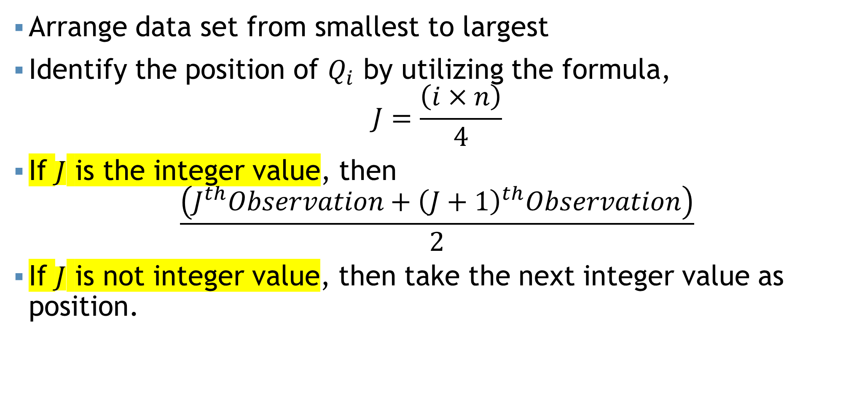
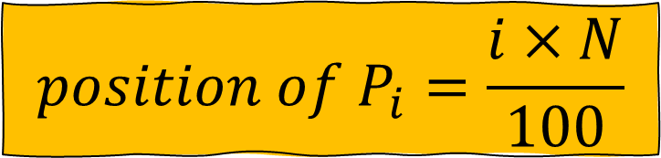
Steps…
$$position of D_{i}=\frac{i×N}{10}$$
$$position of P_{i}=\frac{i×N}{100}$$
Arrange data set from smallest to largest
Identify the position of $Q_{i}$ by utilizing the formula,
$$J=\frac{\left(i×n\right)}{4}$$
If $J$ is the integer value, then
$$\frac{\left(J^{th}Observation+{\left(J+1\right)}^{th}Observation\right)}{2}$$
If $J$ is not integer value, then take the next integer value as position.

Slide 24
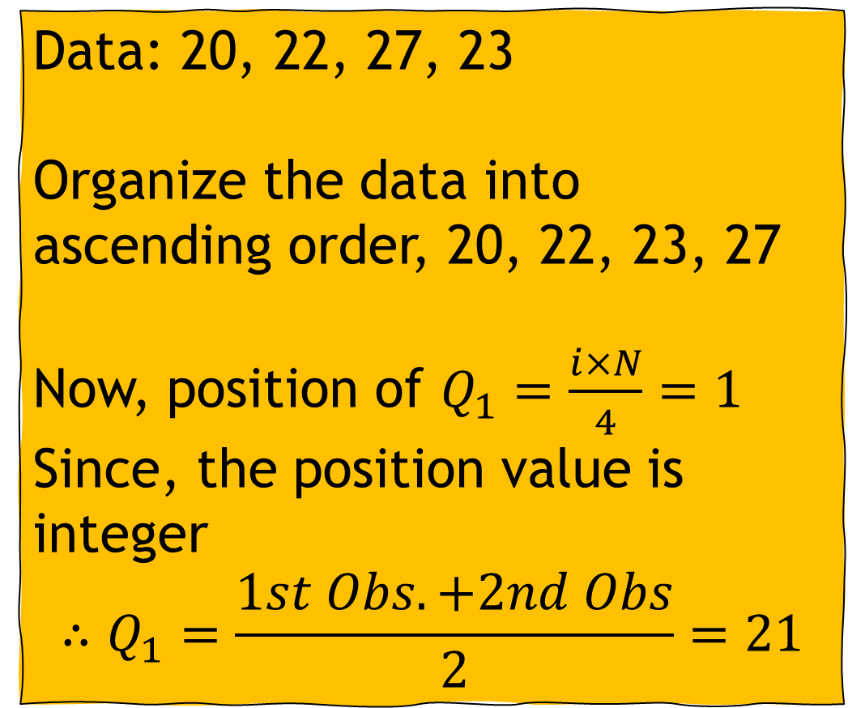
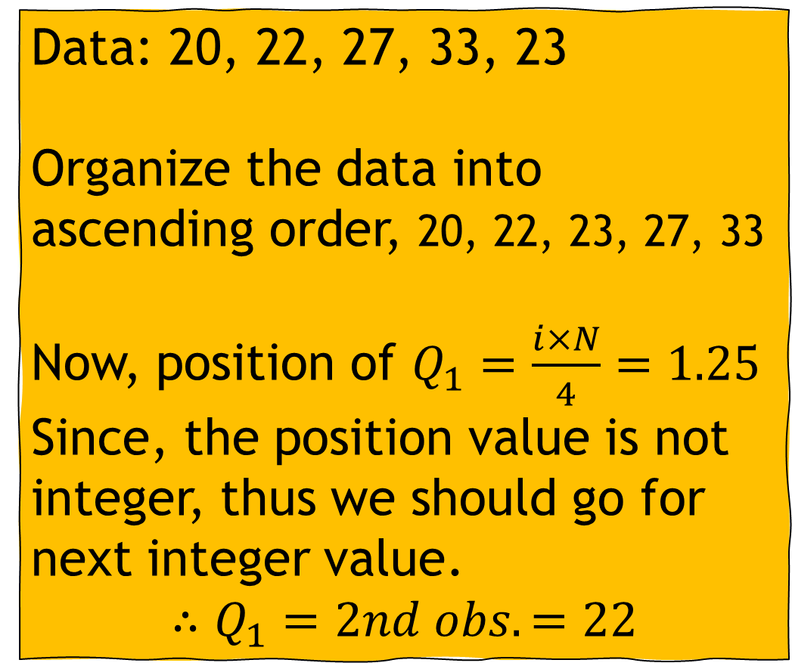
Example (Ungrouped)
Data: 20, 22, 27, 33, 23
Organize the data into ascending order, 20, 22, 23, 27, 33
Now, position of $Q_{1}=\frac{i×N}{4}=1.25$
Since, the position value is not integer, thus we should go for next integer value.
$$∴Q_{1}=2nd obs.=22$$
Data: 20, 22, 27, 23
Organize the data into ascending order, 20, 22, 23, 27
Now, position of $Q_{1}=\frac{i×N}{4}=1$
Since, the position value is integer
$$∴Q_{1}=\frac{1st Obs. +2nd Obs}{2}=21$$

Slide 25

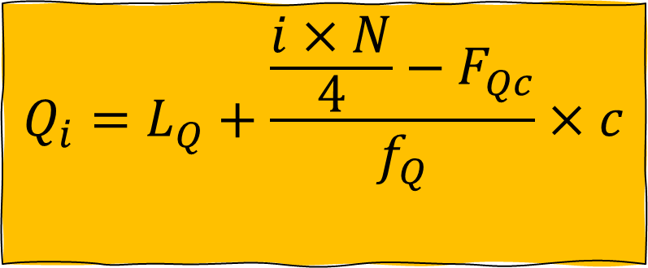
Q, D, and P (Grouped)
$$Q_{i}=L_{Q}+\frac{\frac{i×N}{4}−F_{Qc}}{f_{Q}}×c$$
$$L_{Q}=Lower limit of quartile class$$
$$N=Total number of observations$$
$$F_{c}=Cumultative frequency of pre−quartile class$$
$$f_{Q}=Frequency of quartile class$$
$$c=Class interval$$

Slide 26
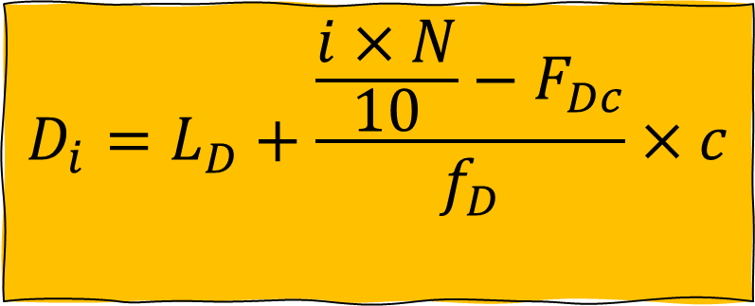
Q, D, and P (Grouped)
$$D_{i}=L_{D}+\frac{\frac{i×N}{10}−F_{Dc}}{f_{D}}×c$$
$$L_{D}=Lower limit of decile class$$
$$N=Total number of observations$$
$$F_{c}=Cumultative frequency of pre−decile class$$
$$f_{D}=Frequency of decile class$$
$$c=Class interval$$

Slide 27
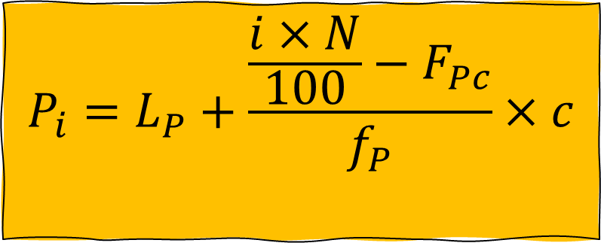
Q, D, and P (Grouped)
$$P_{i}=L_{P}+\frac{\frac{i×N}{100}−F_{Pc}}{f_{P}}×c$$
$$L_{P}=Lower limit of percentile class$$
$$N=Total number of observations$$
$$F_{c}=Cumultative frequency of pre−percentile class$$
$$f_{P}=Frequency of percentile class$$
$$c=Class interval$$

Slide 28

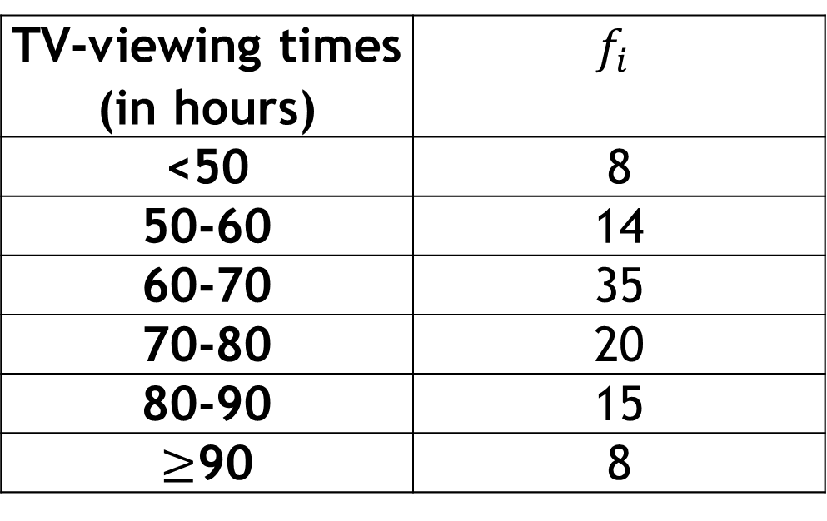
Self Practice
$$\text{Determine} Q_{1}, Q_{2}, and Q_{3} \text{with} \text{interpretation}\text{.}$$
A social organization publishes information on the TV-viewing habits of Bangladeshi garments workers in a report on Television. A sample of 100 garments workers yielded the monthly viewing times, in hours, displayed on the table,
Ans: 60.9, 68, and 79
TV-viewing times (in hours) | $$f_{i}$$
<50 | 8
50-60 | 14
60-70 | 35
70-80 | 20
80-90 | 15
$≥$90 | 8

Slide 29
Mathematical exercise
To access additional mathematical problems, please refer to the PDF lecture notes.

Slide 30
Thank You

